Slide 1



Job shadowing in Italy, piedimonte
Baketta Vasiliki, Papastefanopoulos Athanasios

Slide 2


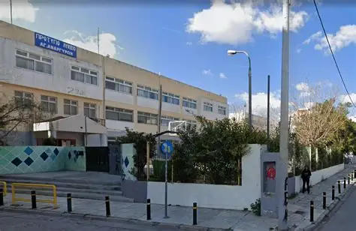
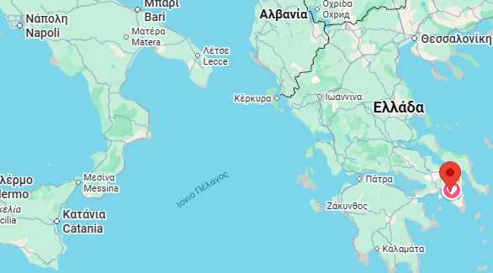
Sending organization
Model Upper Secondary School of Agioi Anargyroi, Athens

Slide 3

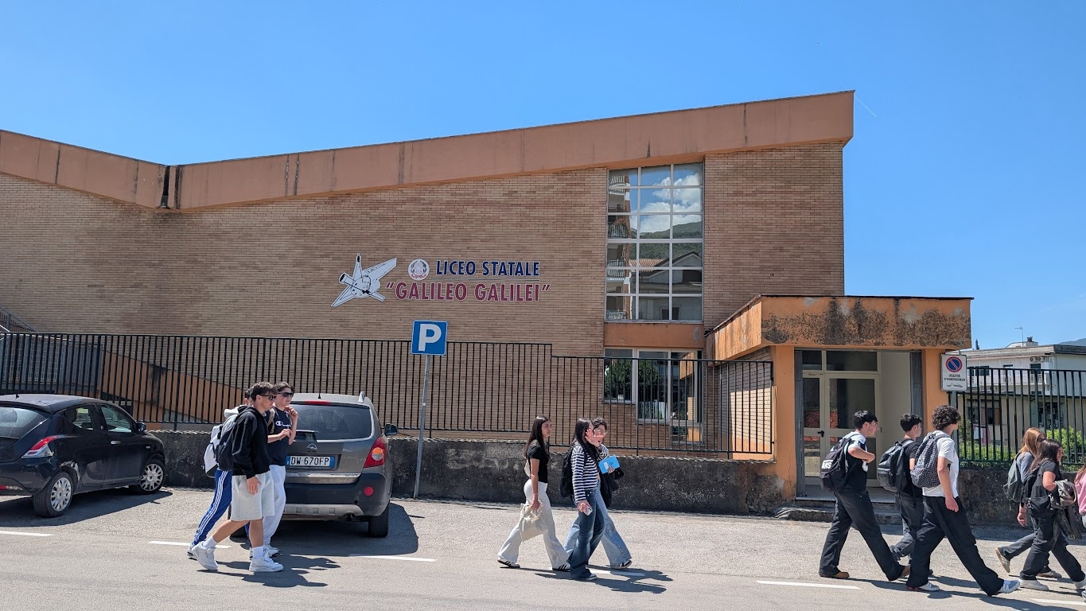
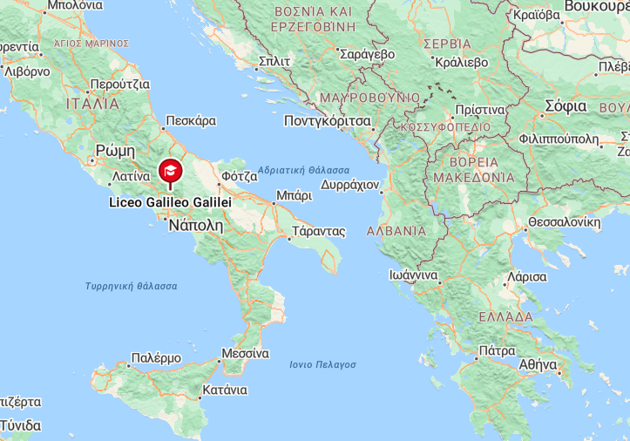
Hosting organization
Liceo Statale Galileo Galilei, Piedimonte Matese Italy

Slide 4
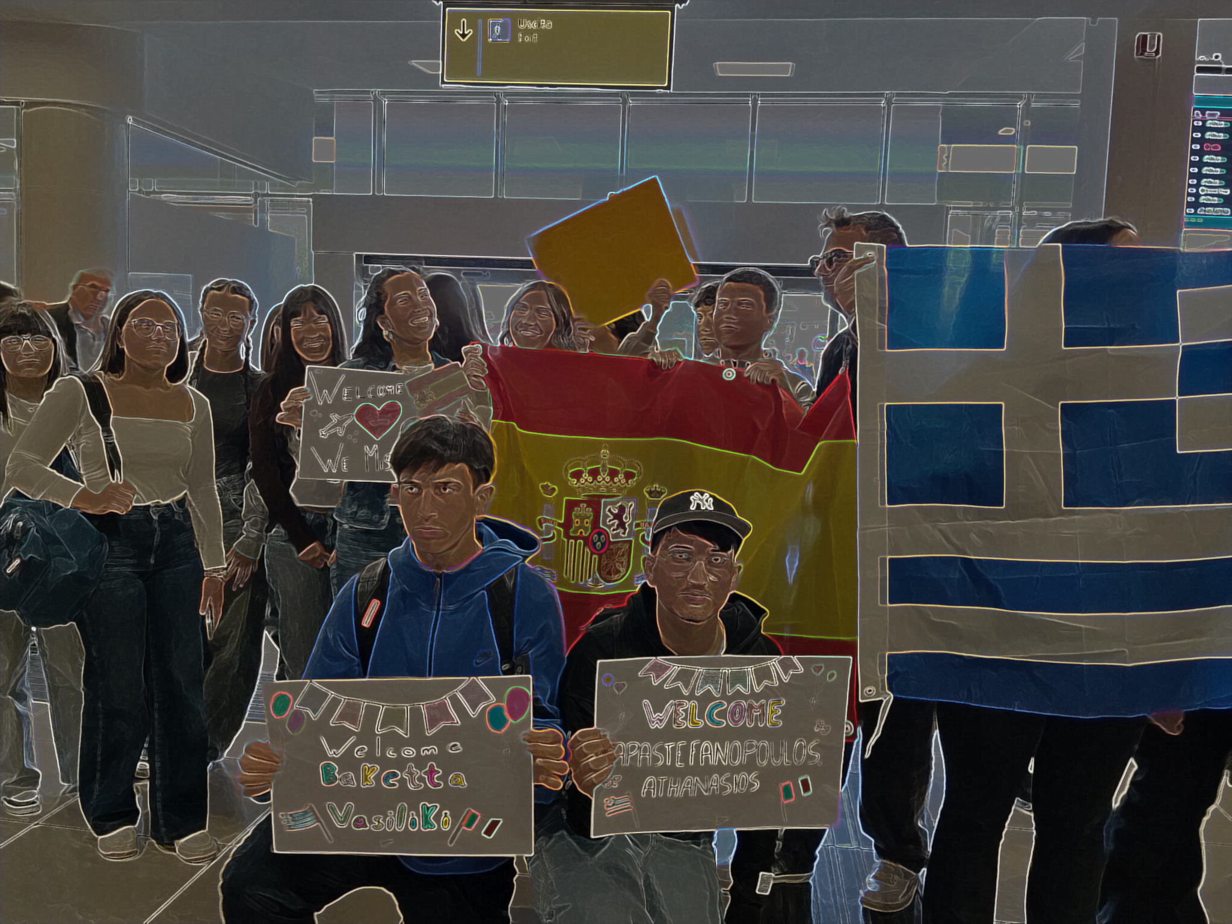
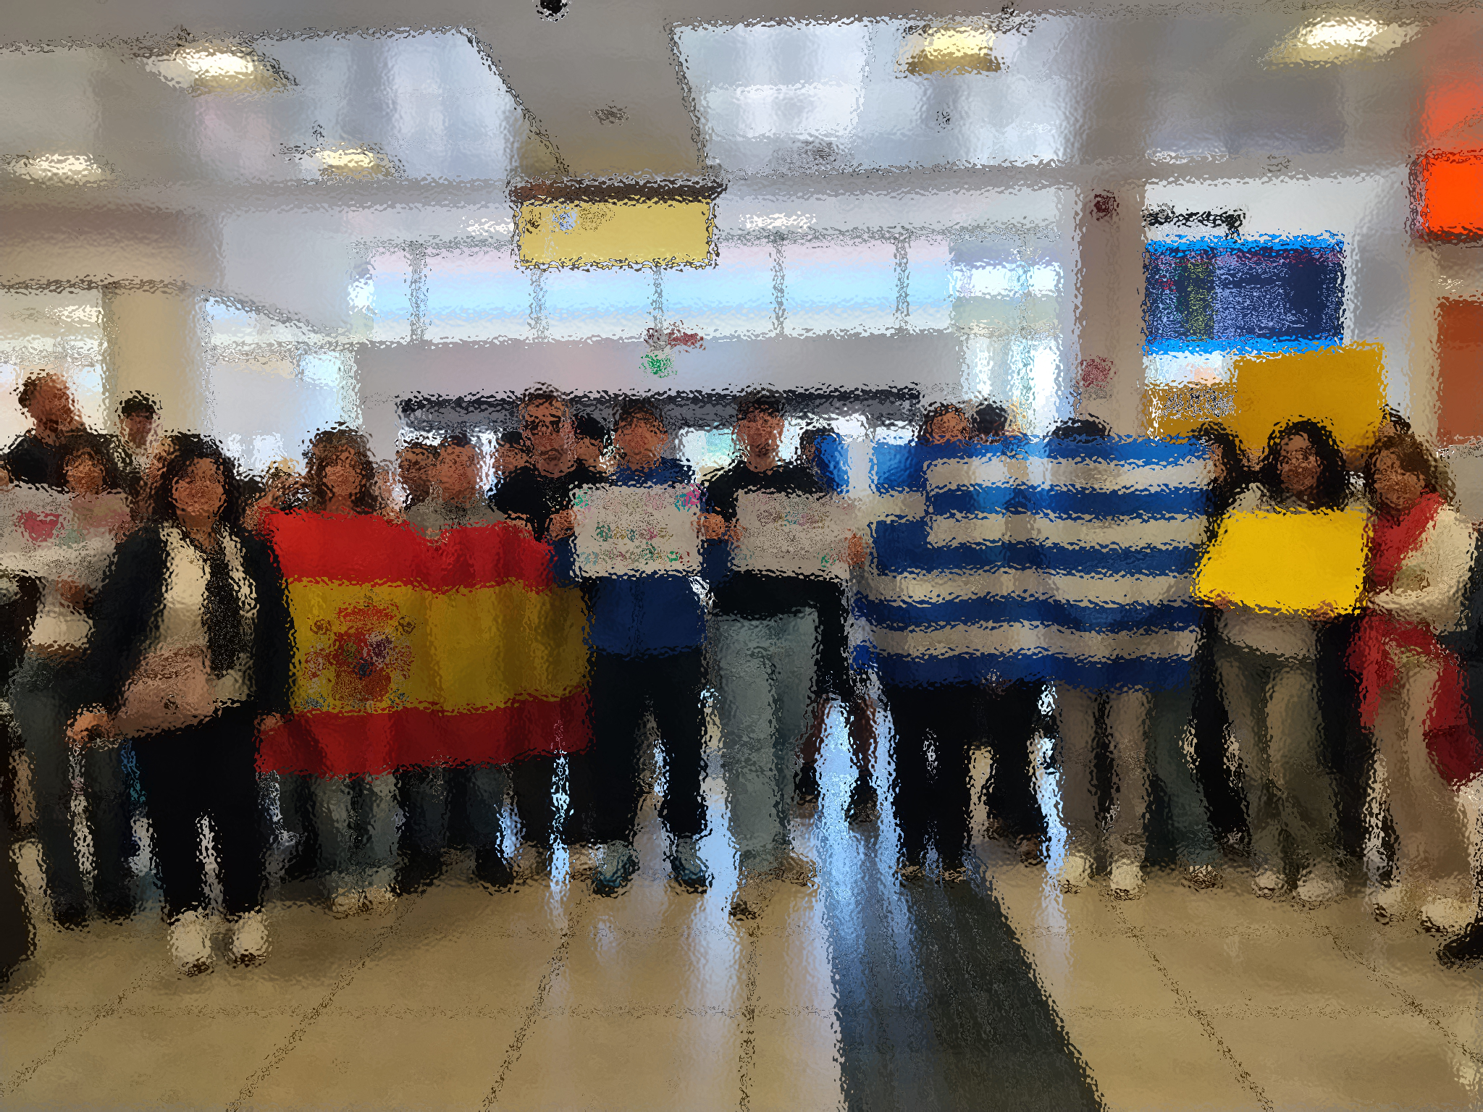
Welcome at the airport

Slide 5
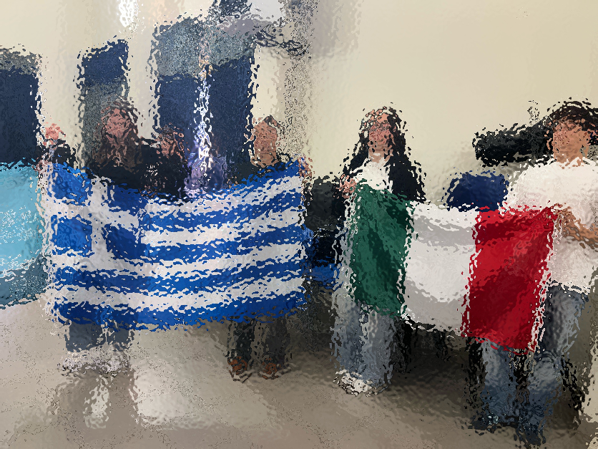
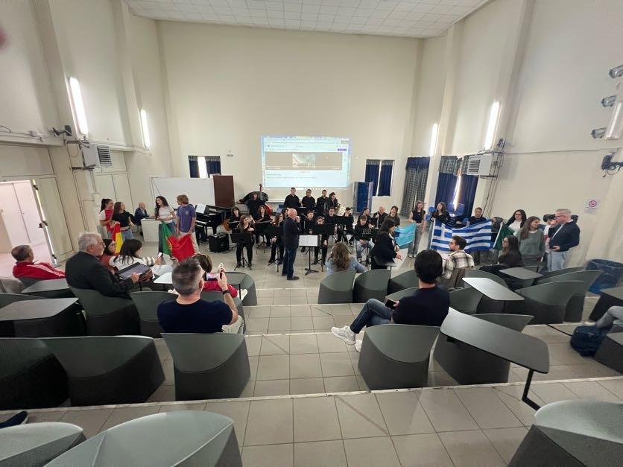
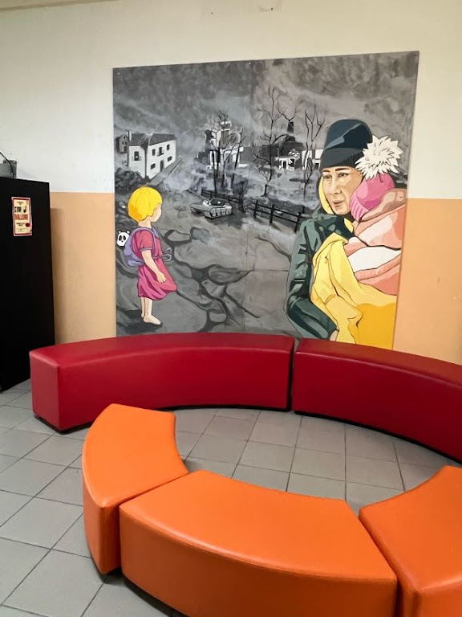
Welcome ceremony at school

Slide 6
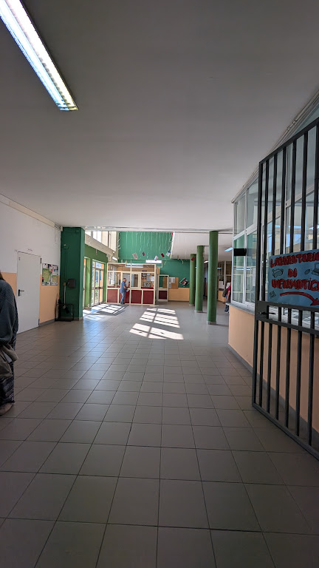
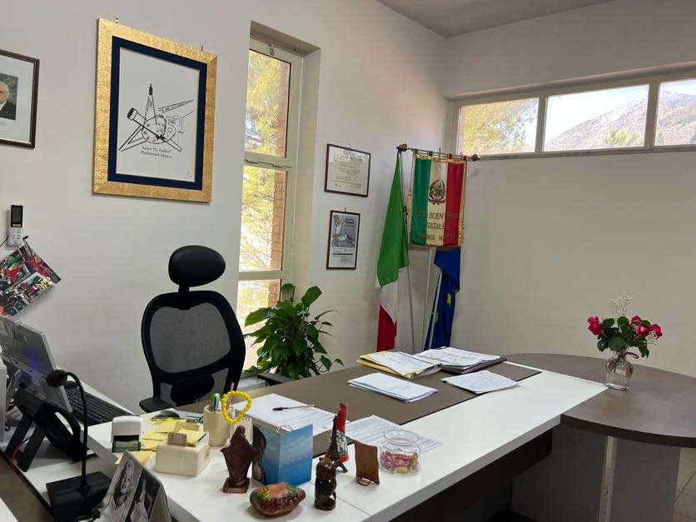
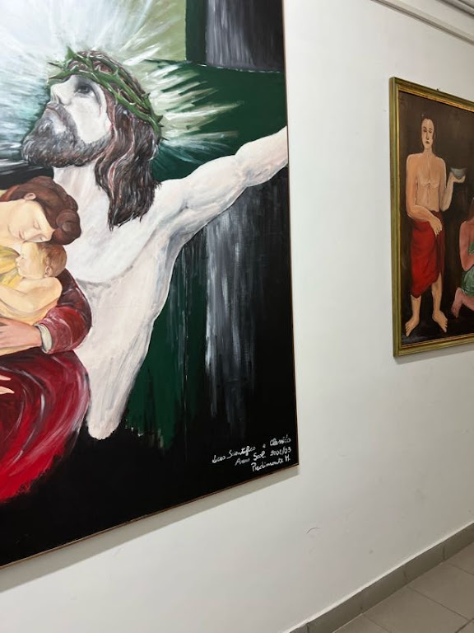
School Tour

Slide 7
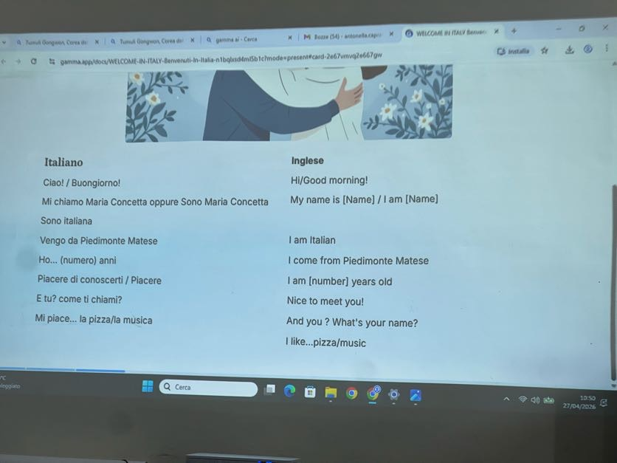
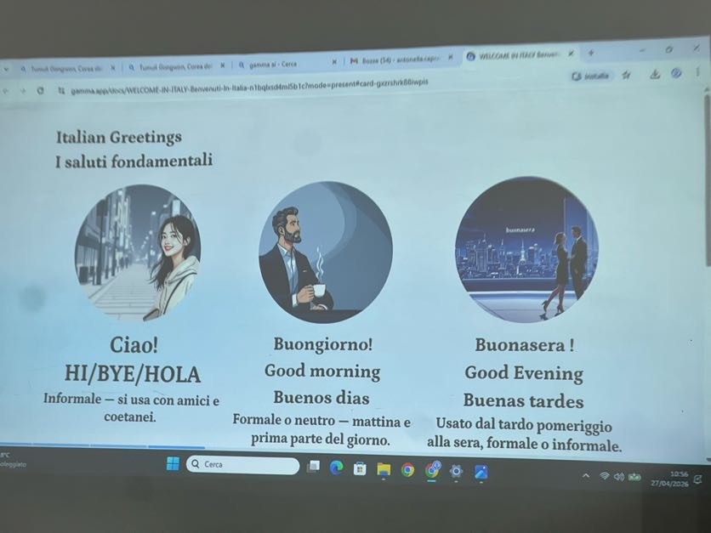
Language (Italian) Lesson

Slide 8
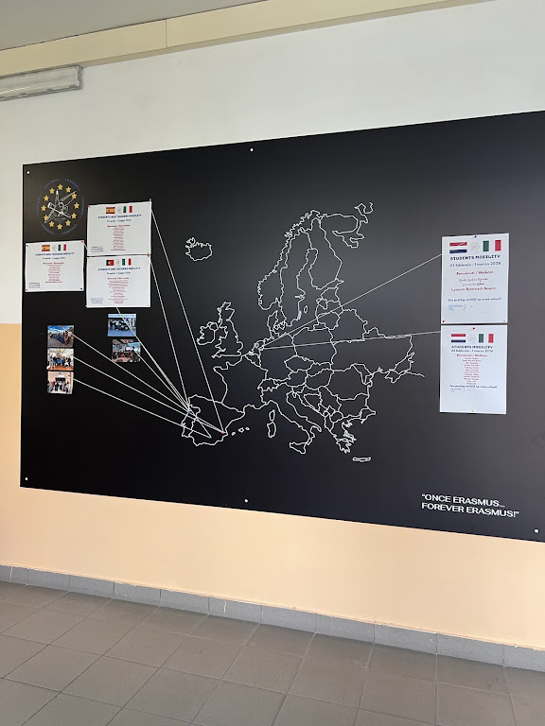
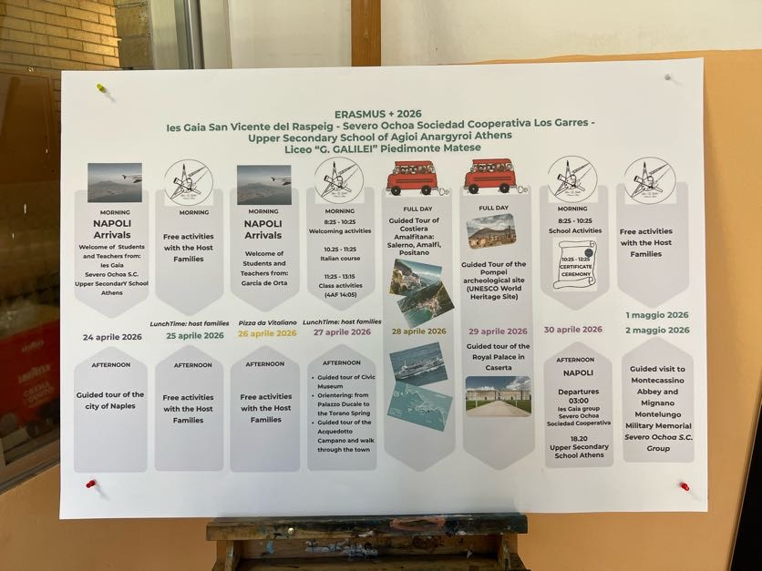
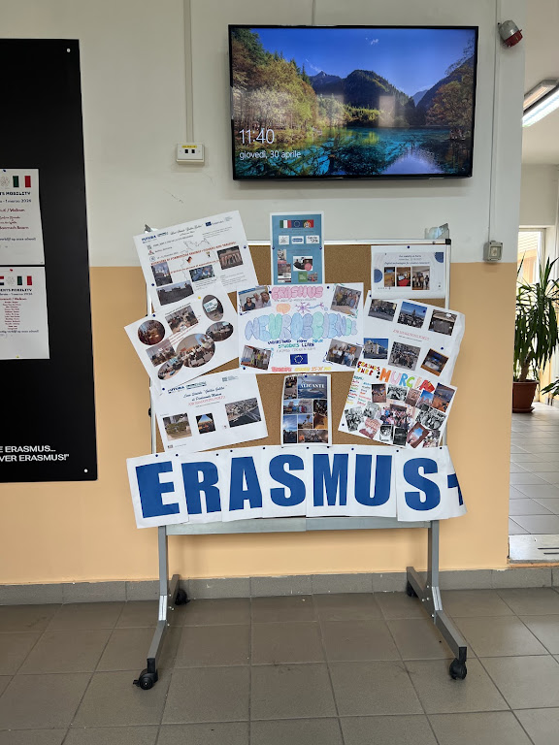
Erasmus+ dissemination at school

Slide 9
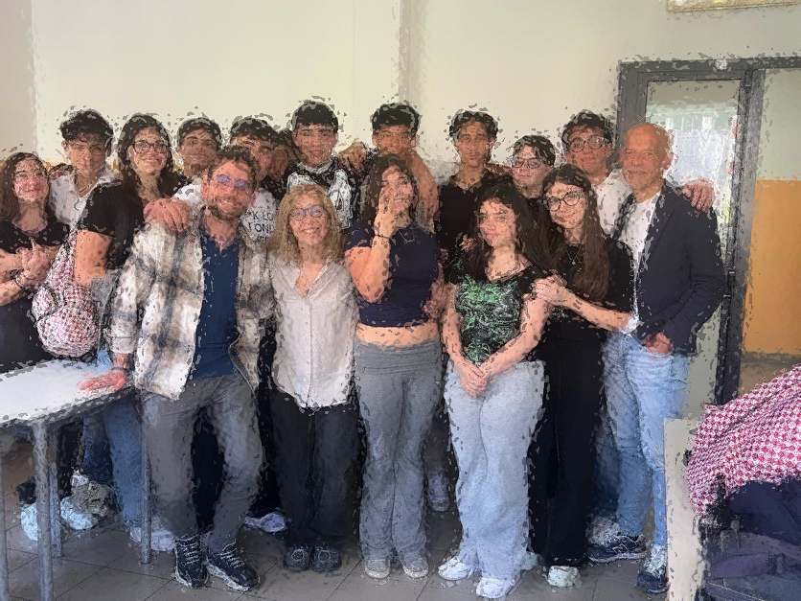
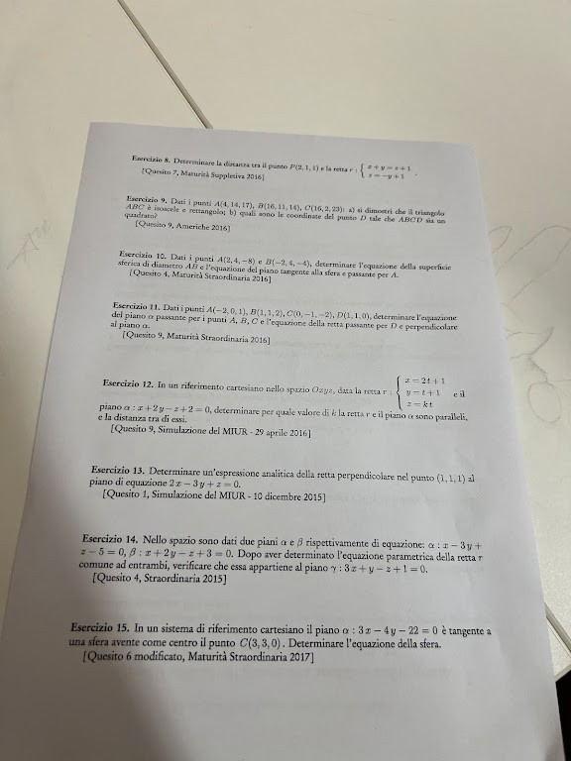
Maths lesson

Slide 10
Comparison of the Italian and Greek Educational Systems
A concise structural overview

Slide 11

Overview
Both countries offer free public education.
Schooling is compulsory until mid-adolescence.
Systems include preschool, primary, lower secondary, upper secondary, and higher education.
Key differences appear in duration, structure, and pathways.

Slide 12
Structure of Education in Greece
Preschool: Kindergarten (4–6, last year compulsory)
Primary: Primary School (6 years, ages 6–12)
Lower Secondary: Gymnasium (3 years, 12–15, compulsory)
Upper Secondary: Lyceum (3 years, 15–18) with General Lyceum (GEL) and Vocational Lyceum (EPAL)
Higher Education: Universities & HEIs
Compulsory schooling: 6–15

Slide 13
Structure of Education in Italy
Preschool: Scuola dell’infanzia (3–6, non-compulsory)
Primary: Scuola primaria (5 years, ages 6–11)
Lower Secondary: Scuola secondaria di primo grado (3 years, 11–14)
Upper Secondary: Scuola secondaria di secondo grado (5 years, 14–19) with Liceo, Tecnico, Professionale
Higher Education: Universities, ITS, academies
Compulsory schooling: 6–16

Slide 14
Comparison Table
Stage | Greece | Italy
Preschool | 4–6 (last year compulsory) | 3–6 (non-compulsory)
Primary | 6 years (6–12) | 5 years (6–11)
Lower Secondary | 3 years (12–15) | 3 years (11–14)
Upper Secondary | 3 years (15–18) | 5 years (14–19)
Compulsory Education | 6–15 | 6–16
Final Exams | Panhellenic Exams | Esame di Stato

Slide 15
Entry to universities in Greece is determined almost entirely by the Panhellenic Exams.
How it works:
Students take national exams at the end of Lyceum (ΓΕΛ/ΕΠΑΛ).
Scores are combined with school grades to produce a final ranking score.
Students submit a preference list (Μηχανογραφικό).
Admission is based on score + available places.
Very competitive fields (Medicine, Law, Engineering) require extremely high scores.
Key feature:
Meritocratic but rigid — performance on a few exam days determines access.

Slide 16
Entry to universities in Italy is More
Flexible, Mixed System. Italy does not have a single national exam for university entry.
How it works:
Students complete the Esame di Stato (state exam) at the end of upper secondary school.
Most universities accept students without entrance exams.
Some fields require admission tests, such as:
Medicine & Dentistry (national test)
Architecture
Veterinary Medicine
Engineering (in some universities)
Health sciences
Students apply directly to universities.
Key feature:
Open access for most fields, selective only for regulated professions.

Slide 17
Key Similarities
Strong public education systems
Compulsory schooling until ~15–16
National exams at the end of upper secondary
Pathways to higher education through standardized assessment

Slide 18
Key Differences
Italy has a 5-year upper secondary; Greece has 3 years
Italy offers more specialized tracks (Liceo, Tecnico, Professionale)
Greece uses national centralized exams for university entry
Preschool is compulsory in Greece, not in Italy
Italian grading: 1–10; Greek grading varies by level

Slide 19
Conclusion
Both systems share a European structure but differ in duration, specialization, exams, and preschool requirements.

Slide 20
School Life
Type of school | Greece | Italy
Liceo Classico Focus on Latin, Greek, philosophy | 32-35 hours/week | 27-31 hours/week
Liceo Scientifico Emphasis on math and science | 32-35 hours/week | 27-31 hours/week
Liceo Linguistico Three foreign languages studied | - | 27-31 hours/week
Liceo delle Scienze Umane Psychology, pedagogy, sociology | 32-35 hours/week | 27-31 hours/week
Liceo Artistico / Musicale More practical/artistic subjects | - | 30-35 hours/week

Slide 21
School Life
6 working days (Monday–Saturday)
Teachers have one day off, the same for each year
Lesson duration 55-60 minutes
1 main break (15-20 min) + sometimes a short 5‑min pause. Students stay inside the building (most schools don’t allow going outside during breaks). They move briefly around the corridor or classroom, but not far; teachers often supervise. There’s usually no cafeteria, but vending machines for snacks and coffee. Students remain in the same classroom all day, while teachers rotate. So the break feels like a quick reset rather than a full recess — more academic, less social than in Greece.
What’s Not Allowed: Leaving the school premises, Going to nearby cafés or shops, Large gatherings or loud music — breaks are short and meant for rest.
Schools emphasize punctuality and independence — students manage their own materials and schedules.
Afternoons are used for homework, tutoring, or extracurriculars (music, sports, volunteering).

Slide 22
School Life
Use of project-based learning is implemented in the school: students are organised and grouped, and use inclusive strategies to ensure the participation and success of all learners.
students’ emotional well-being is supported
Differentiated instruction and tailored support strategies are implemented for SEN students.
Oral and written examinations - grades

Slide 23
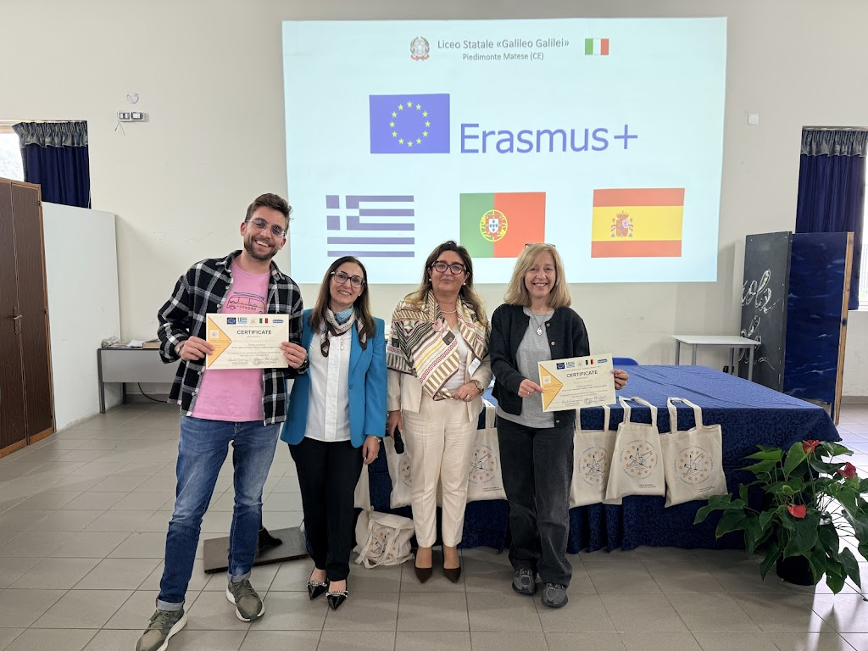
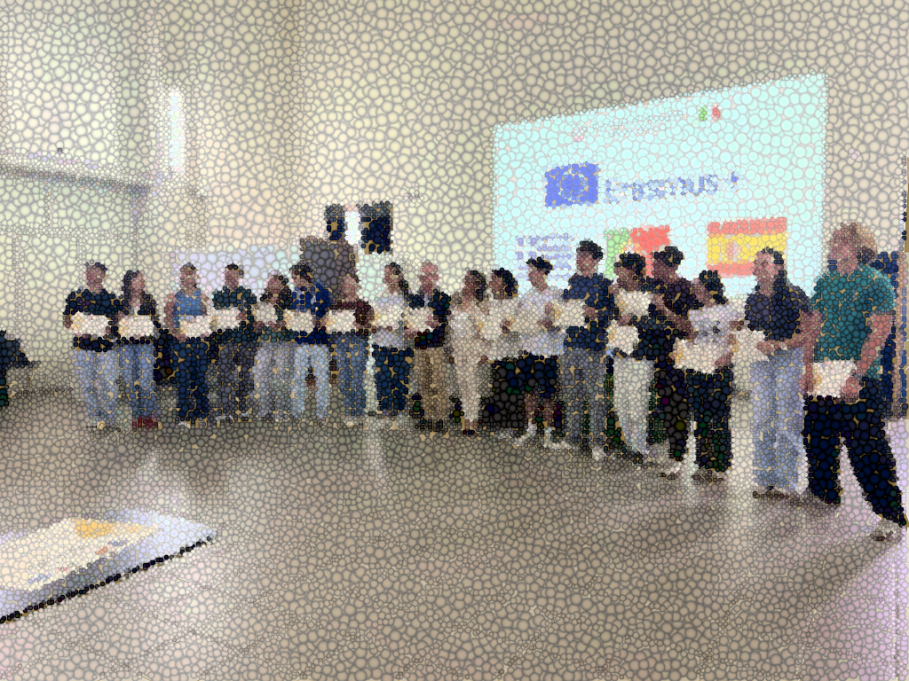
Certification

Slide 24
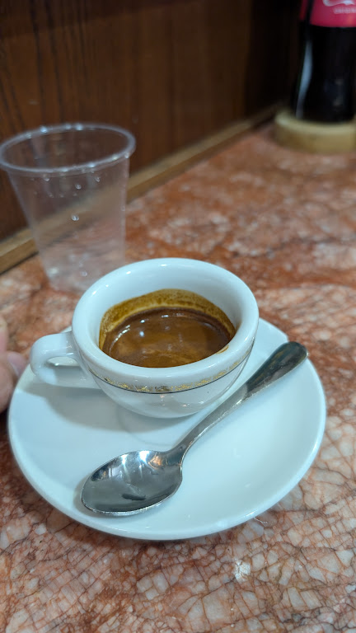
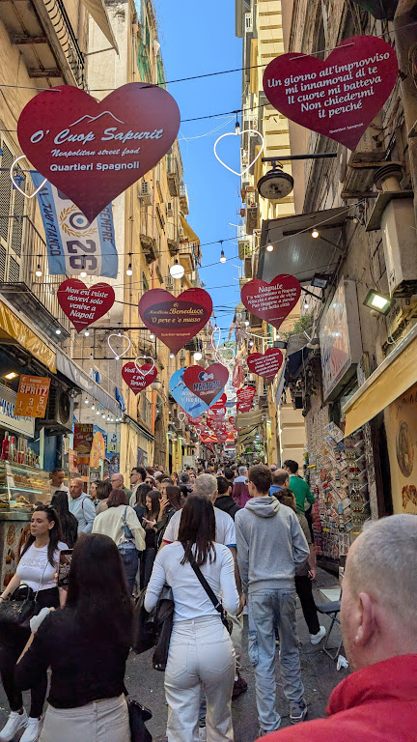
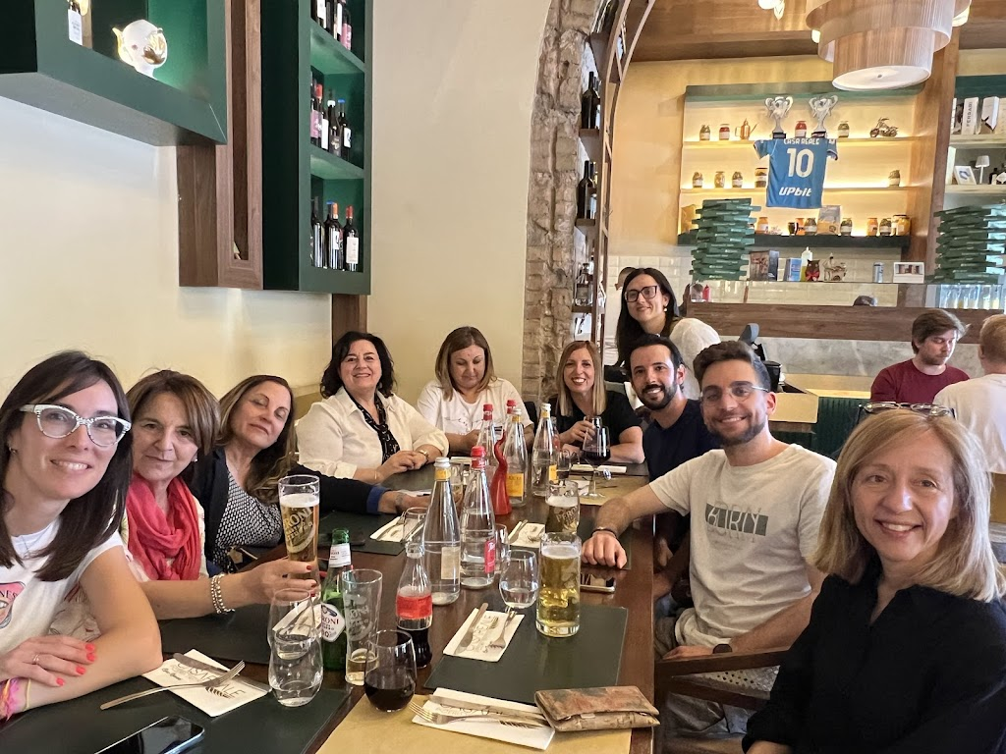
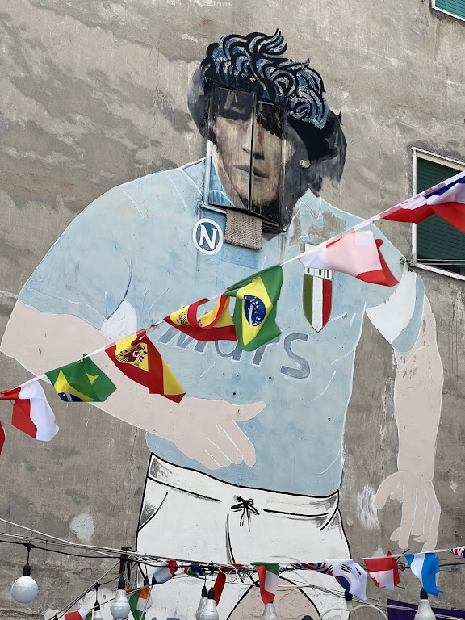
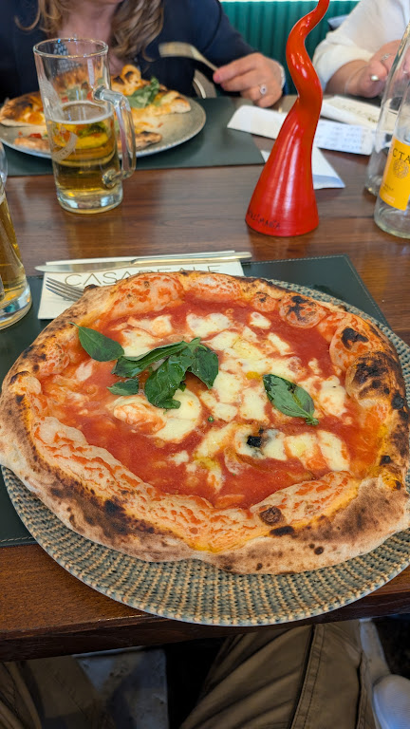
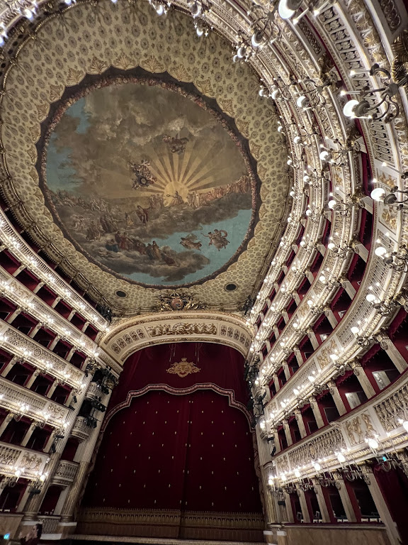
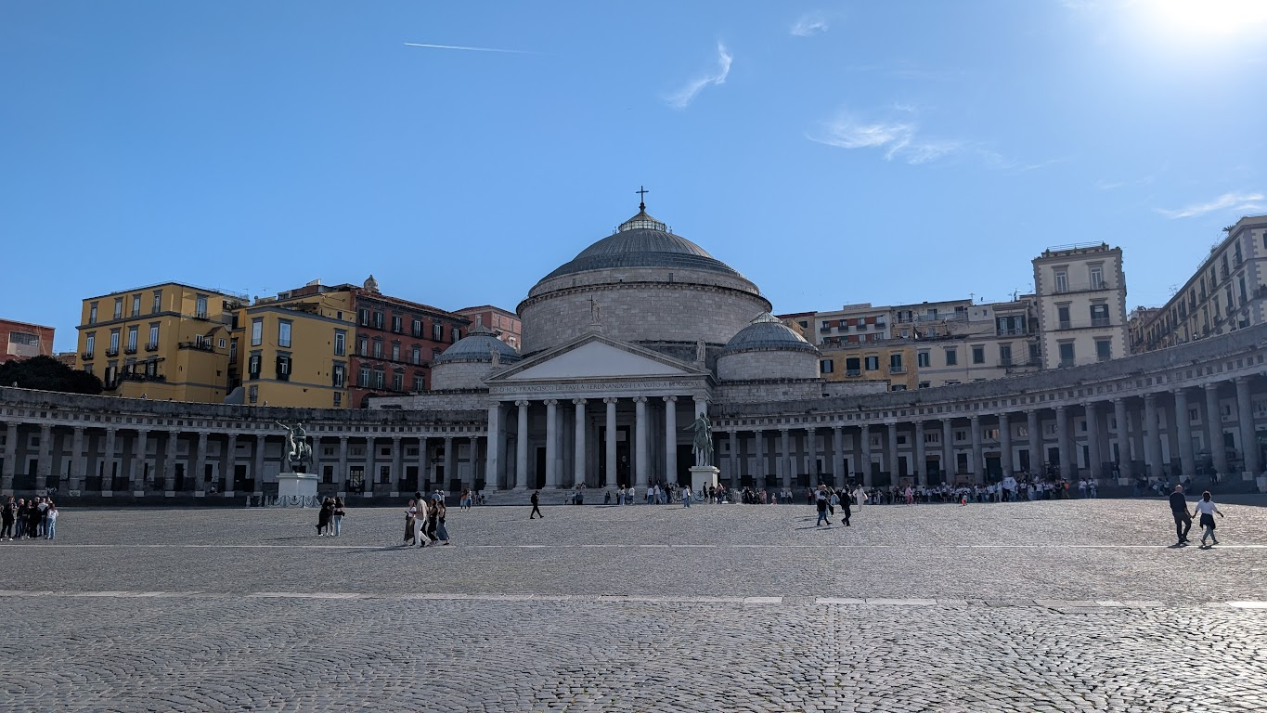
Napoli

Slide 25
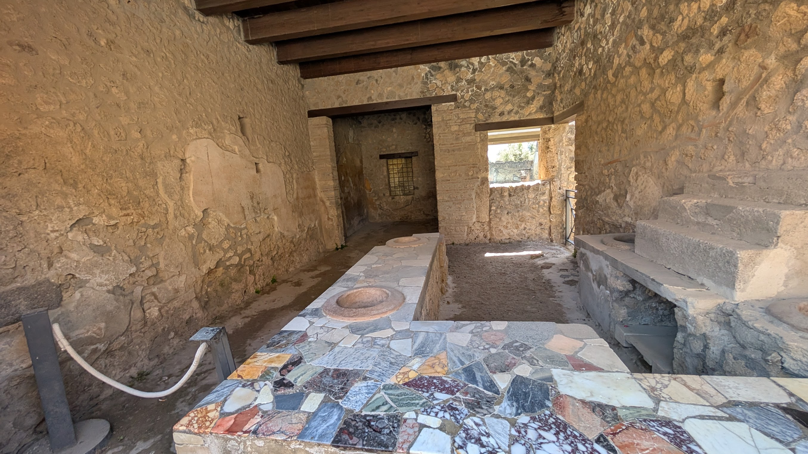
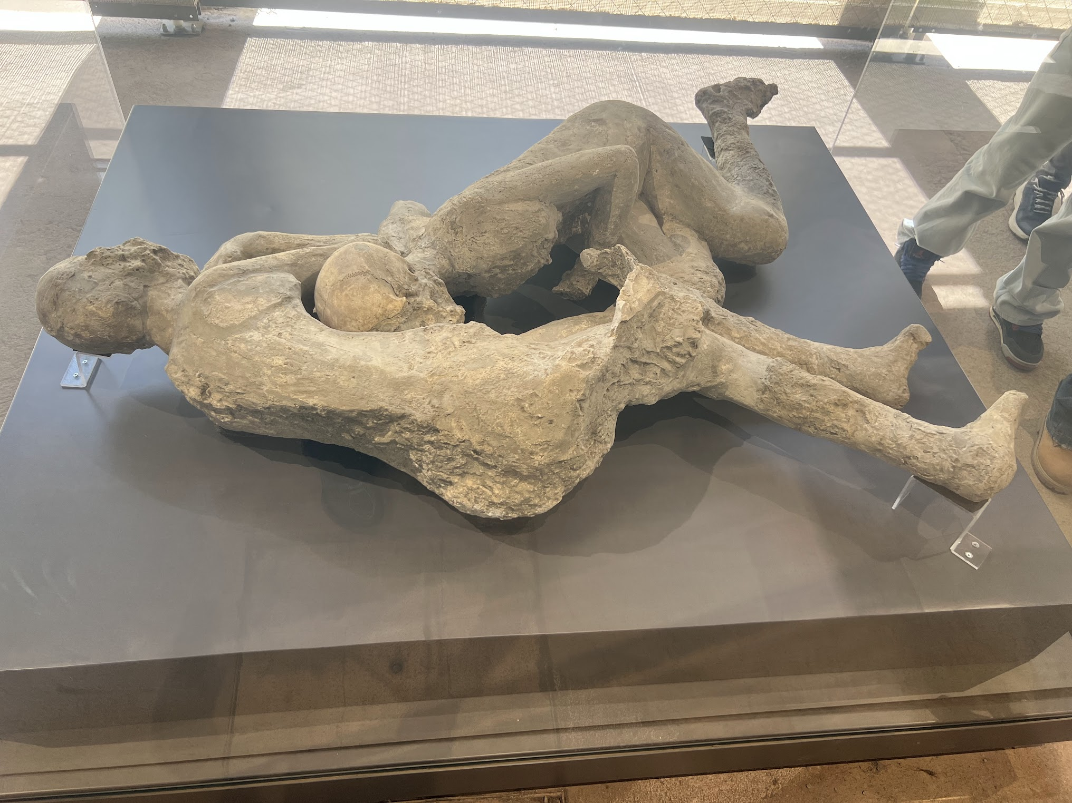
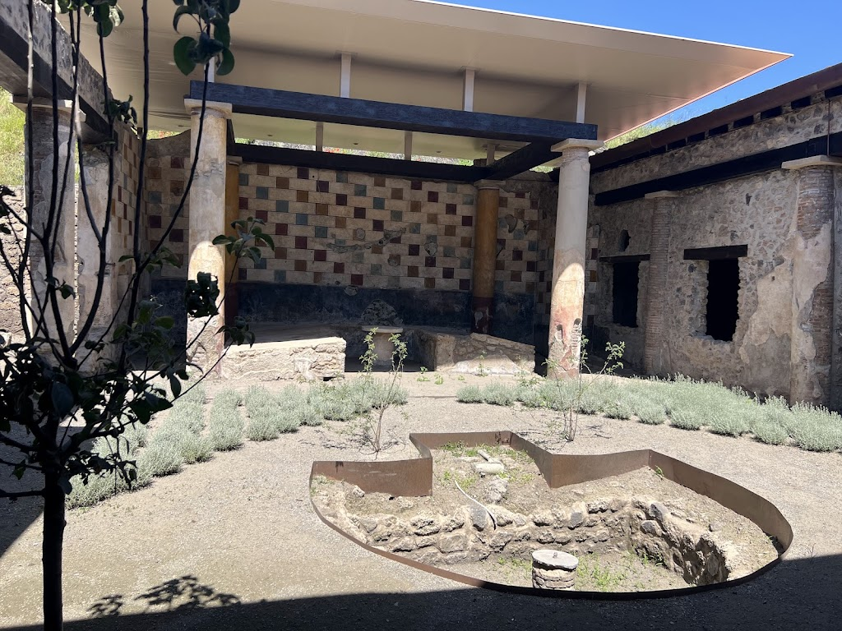
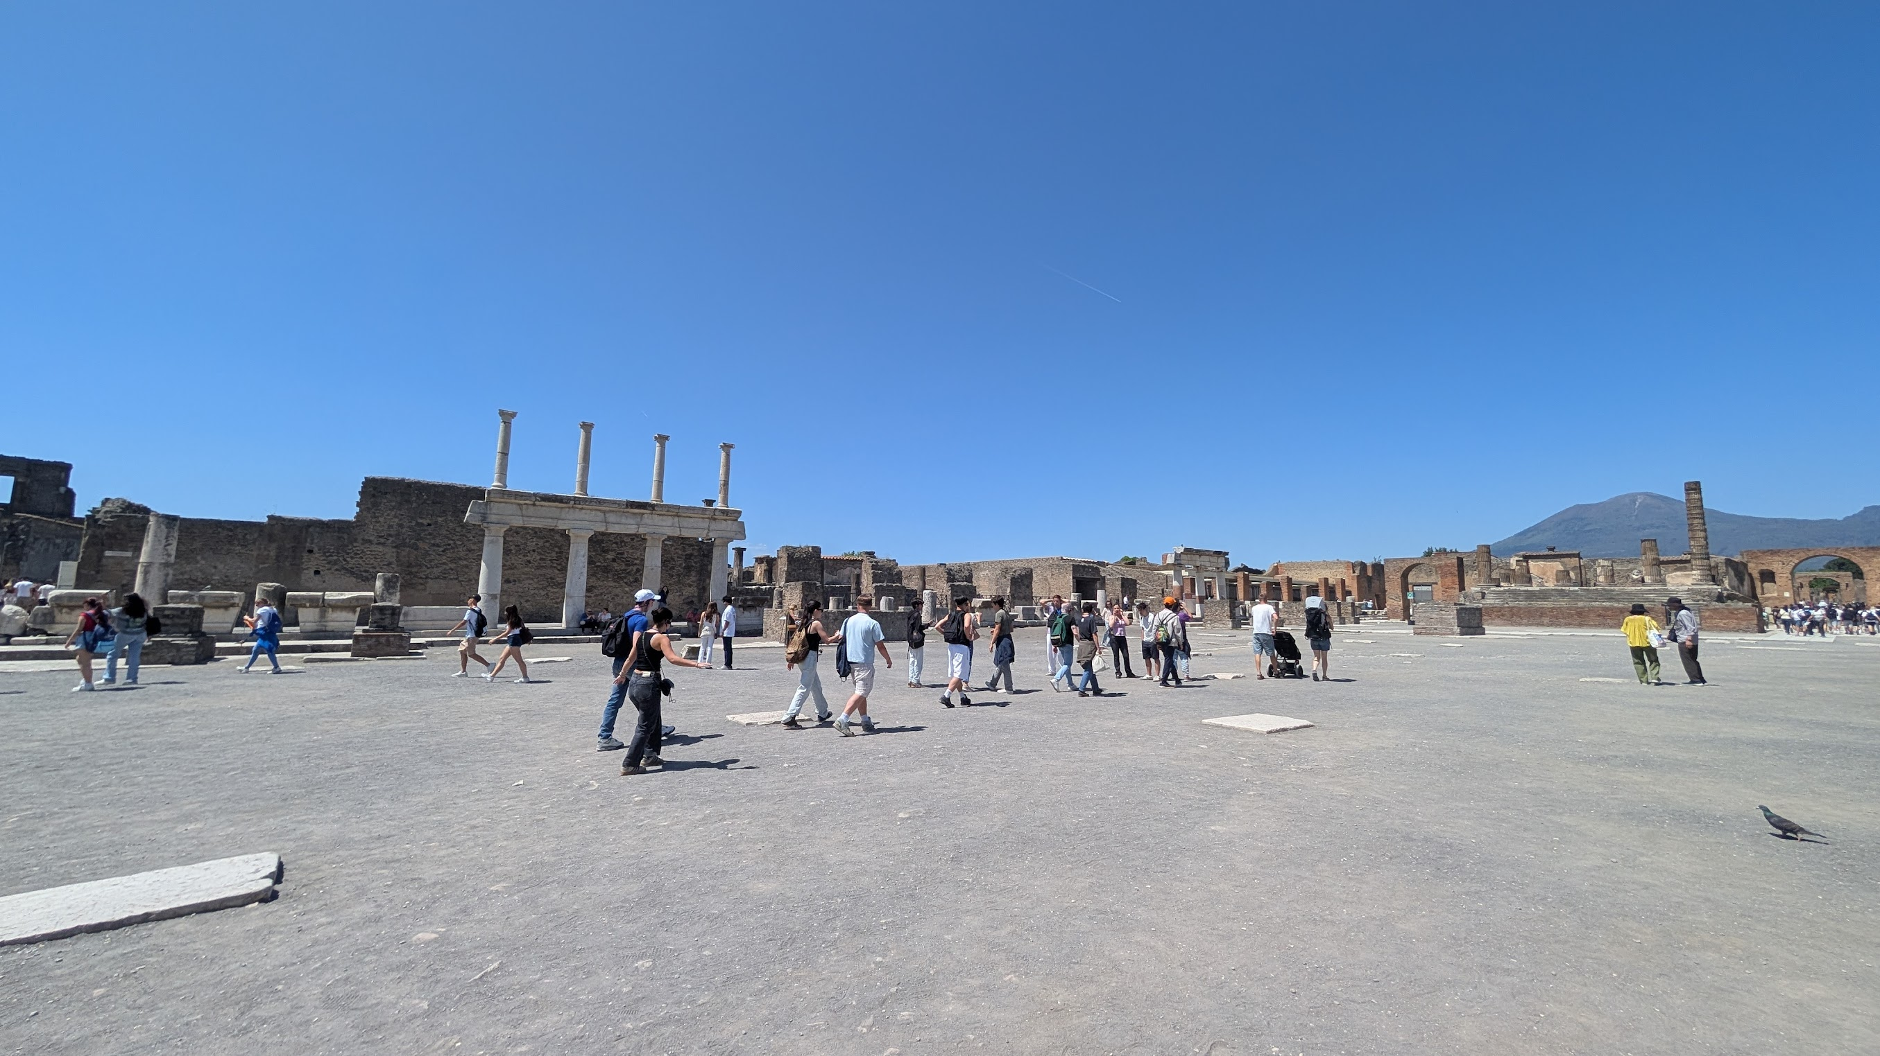
Pompei

Slide 26
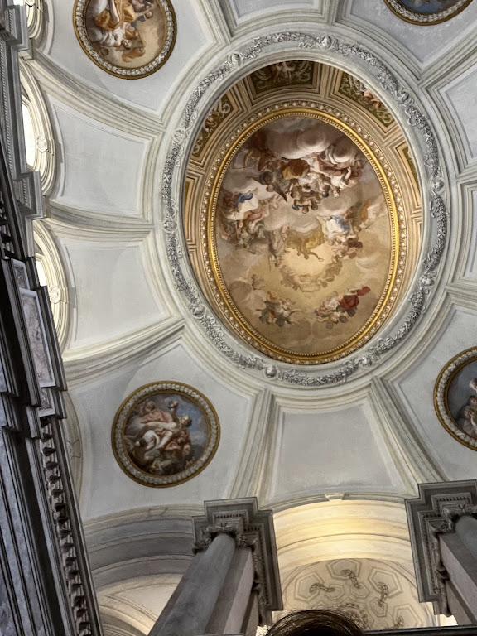
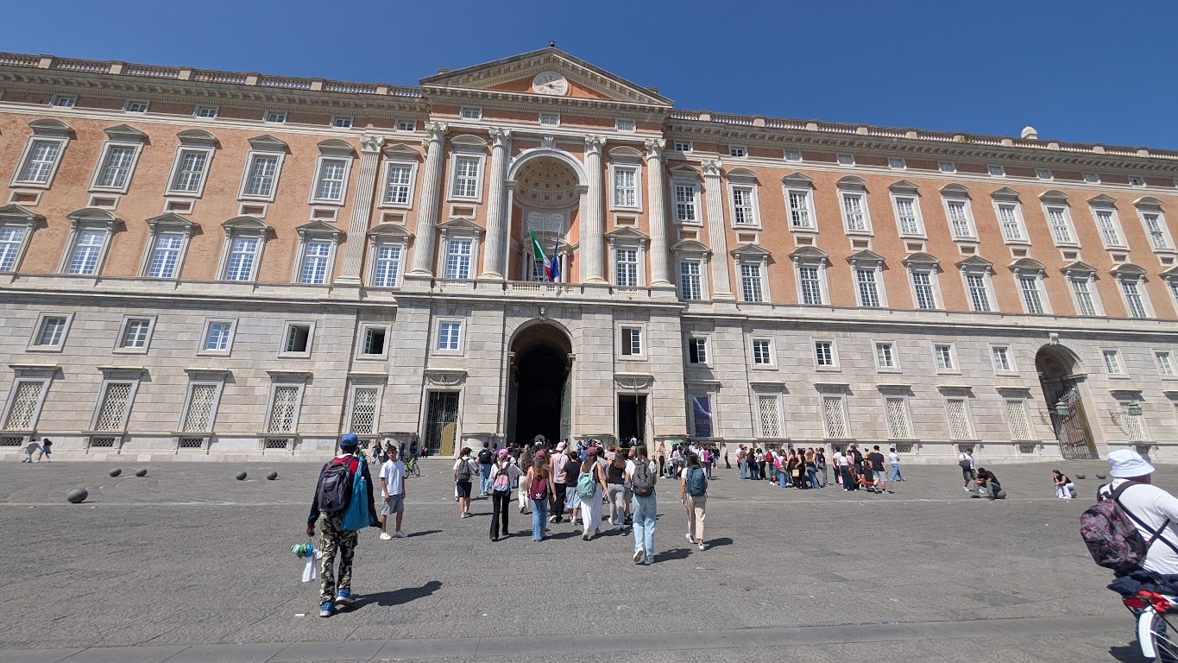
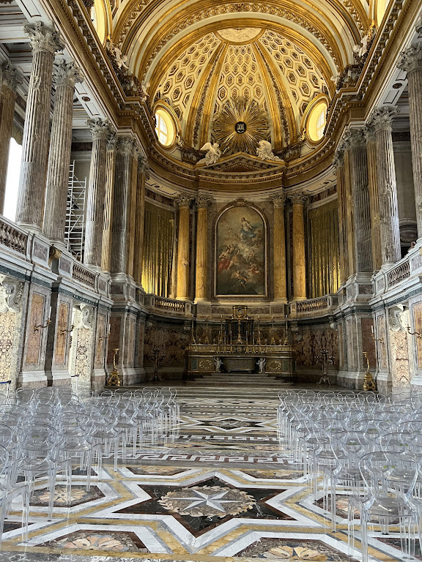
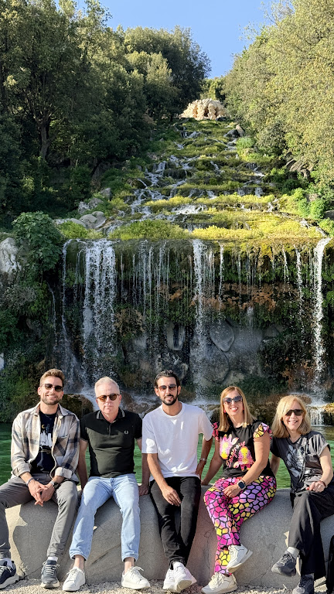
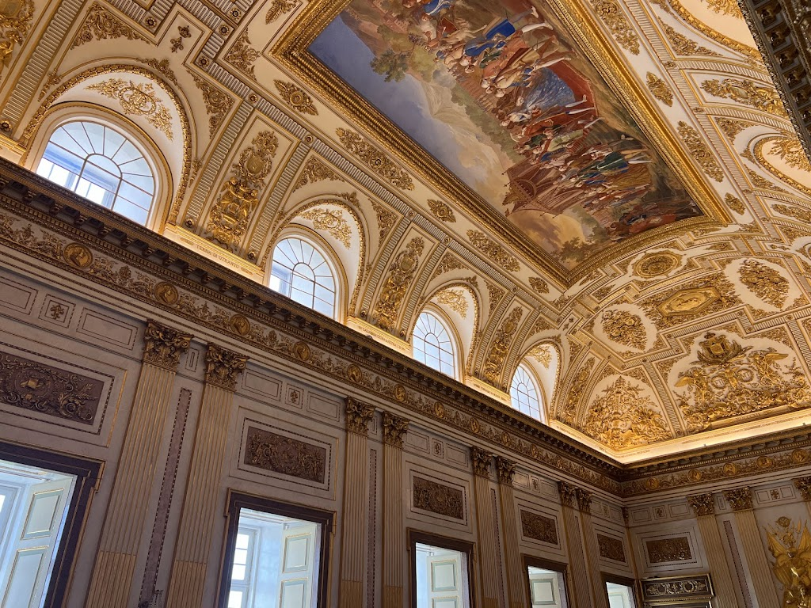
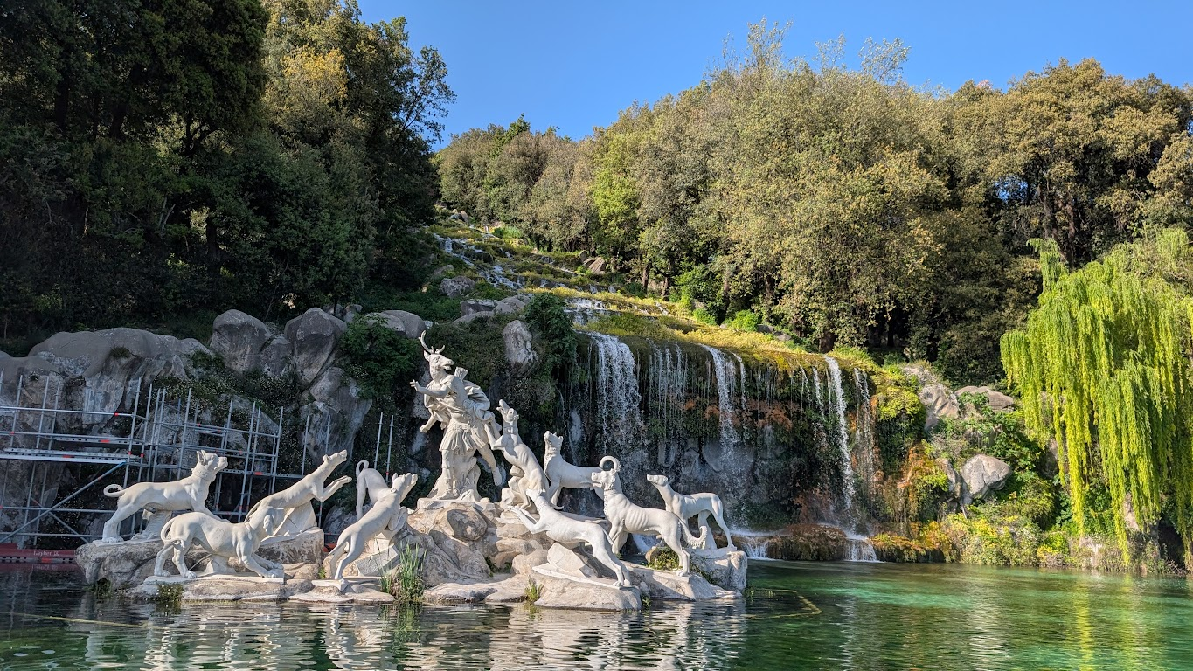
Casarte

Slide 27
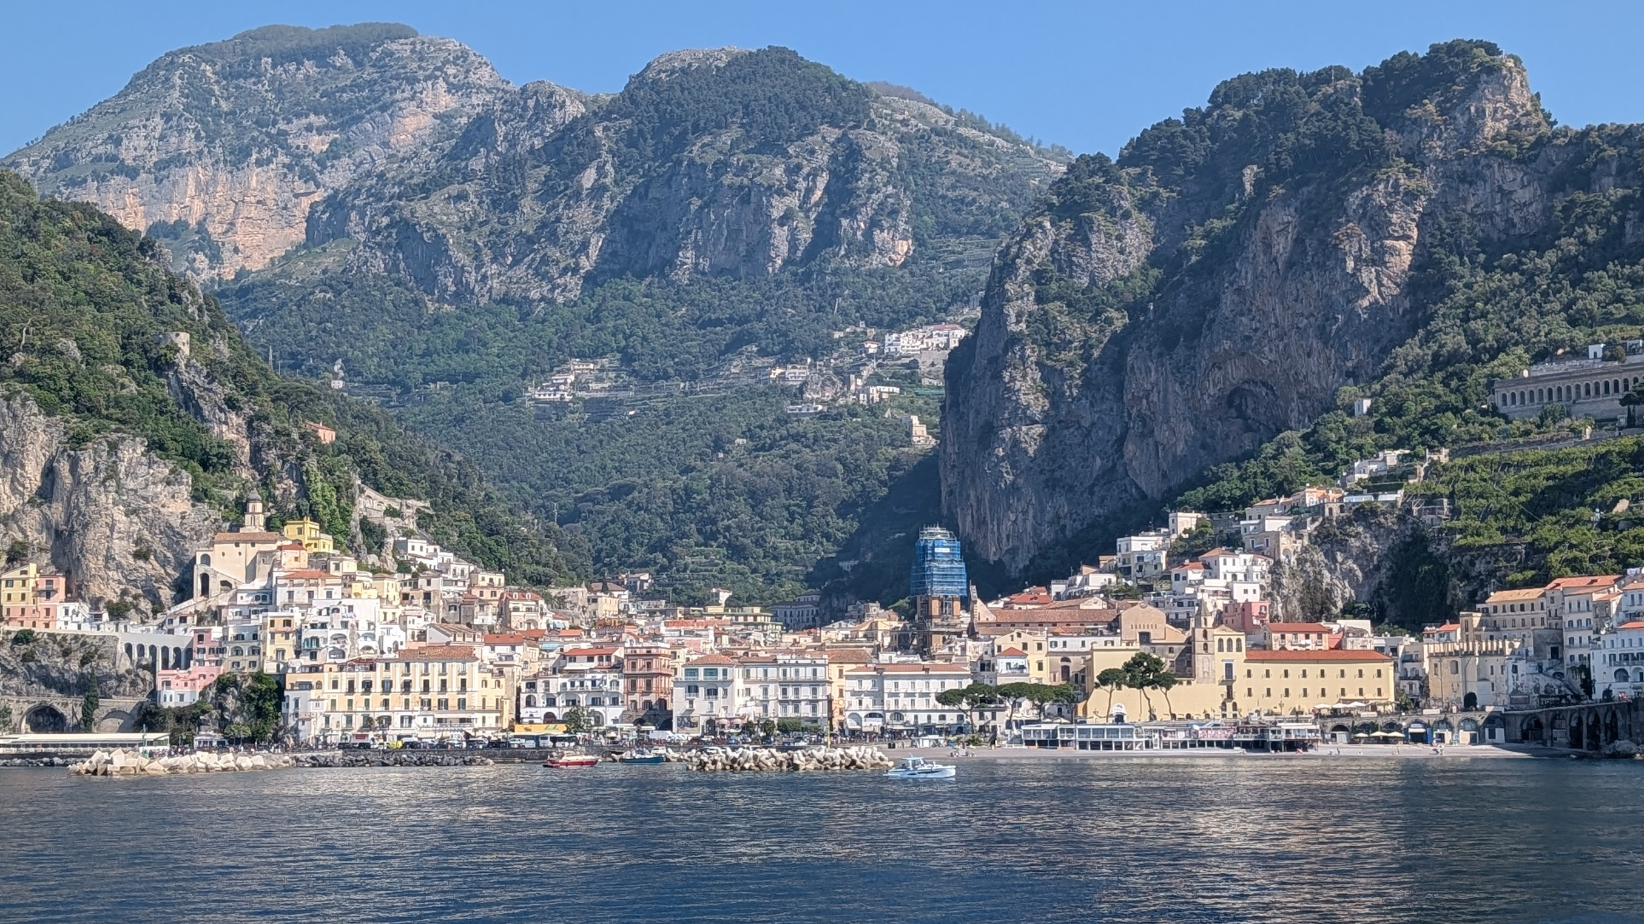
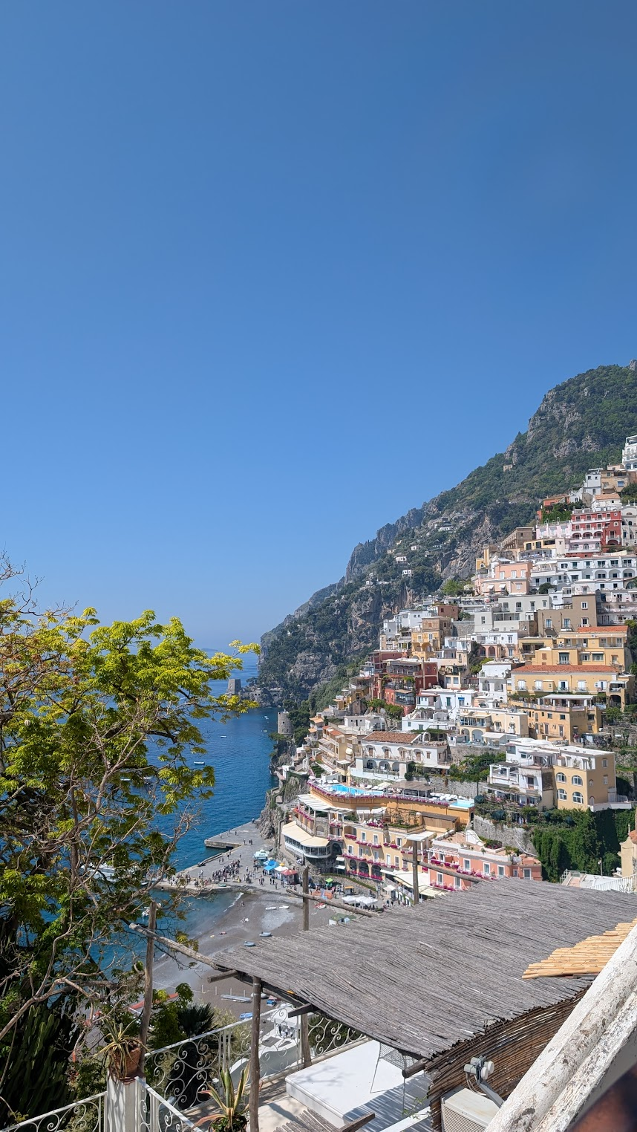
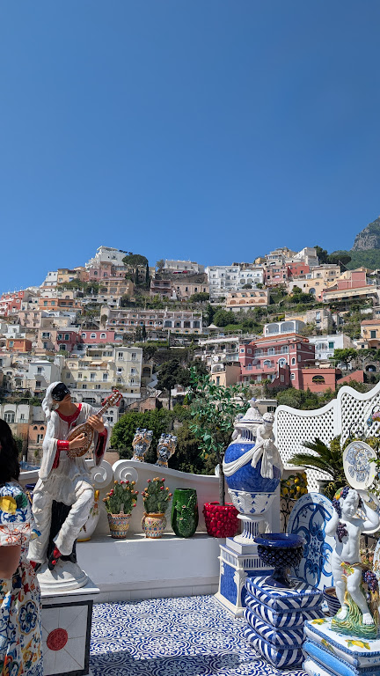
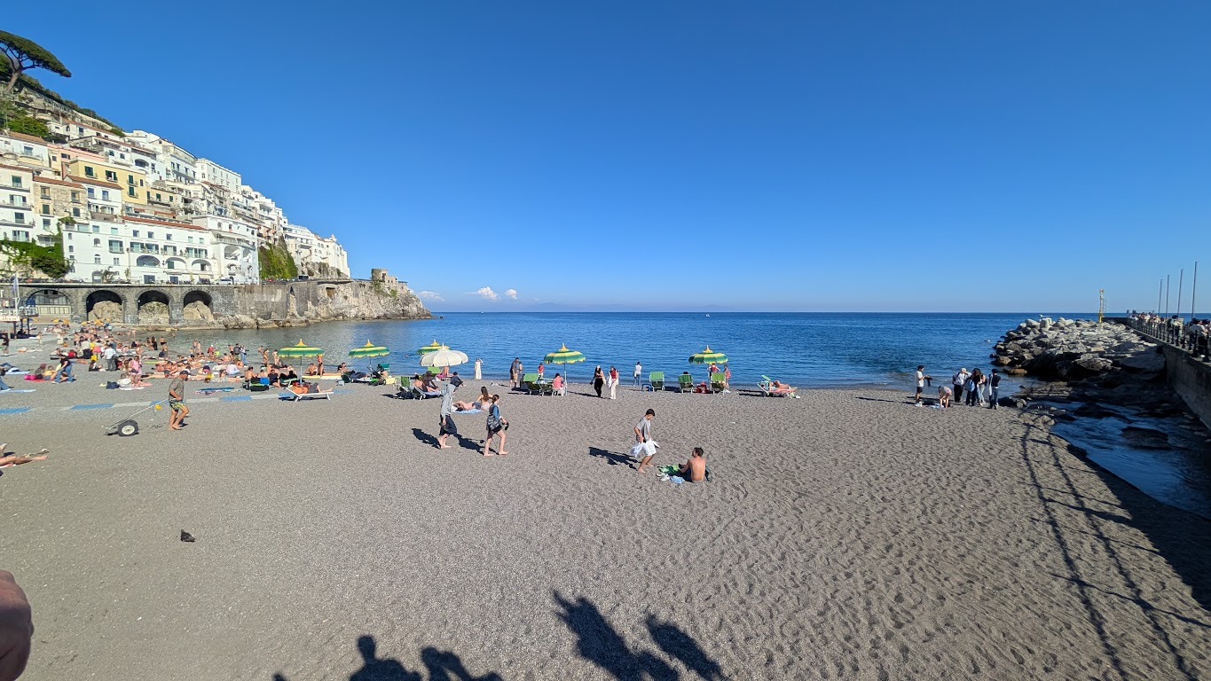
Positano-Amalfi

Slide 28
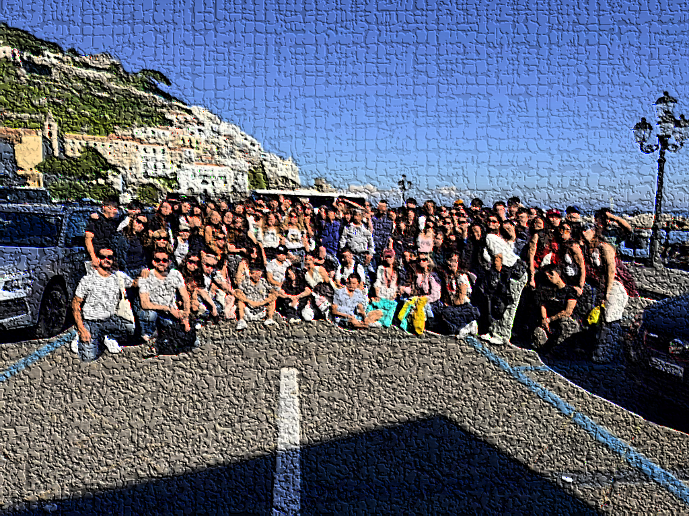
Once Erasmus… forever erasmus

